Slide 1

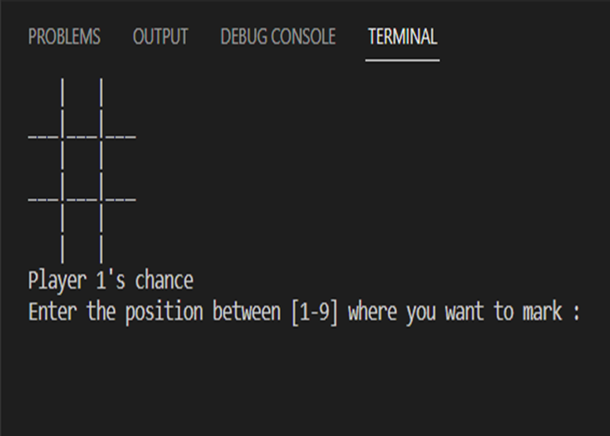
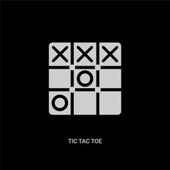

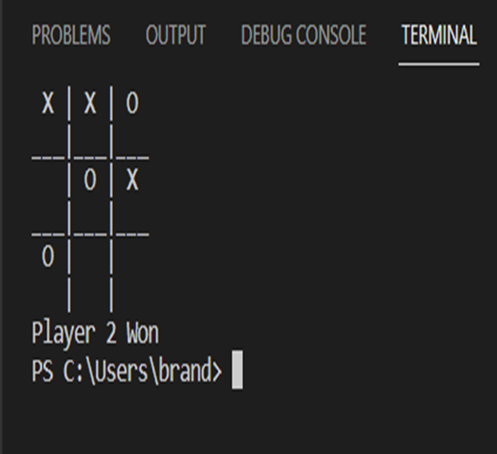
Tic-Tac-Toe Game
By: Xavier Cannady
This is a simple game of Tic-Tac-Toe created using a “drawboard()” function and you mark your position on board using keys 1-9.

